Slide 1
Group Presentation
Team 8
Team member names: Anna N., Sohini B., & Jenny H.

Slide 2
Overview
Our goal: Determine whether Susan’s current rate of retirement savings is adequate
Notes:
sohini

Slide 3
Some basic information about Susan
46 years old
Annual salary is $145,000
Employer contribution is 5%
Own contribution is $11,500
The CV of your retirement fund is $182,000
Notes:
sohini

Slide 4
We make a few assumptions
Your life expectancy is 30 years after you retire
You will retire at the age of 65
To keep up with inflation, your employer will slightly increase your salary by 5% each year
You will withdraw $20,000 per year from your account after retirement, which means that you need $500,000 in savings to last up to 30 years after retirement
Notes:
sohini
Reference about inflation: https://www.cnbc.com/2021/12/12/why-workers-should-expect-a-raise-and-that-it-wont-match-inflation.html

Slide 5
Our methodology
We added up the total investment (or contribution) amount and ending balance of your retirement fund from previous year together to arrive at the ending balance for the current year, then we did the same thing up until you reach your retirement age
We computed the annual rate of return for each year, then we computed the annualized return using the CAGR method
Notes:
anna

Slide 6
Reasonings behind our methodology
Annual return | Annualized return (CAGR)
We use this to measure how much your investment has been going up in one year. | We use this to measure your annual rate of return over 19-year period utilizing your annual rate of return or ending balance of your retirement fund
Notes:
anna
Source: https://www.indeed.com/career-advice/career-development/how-to-calculate-annualized-return

Slide 7
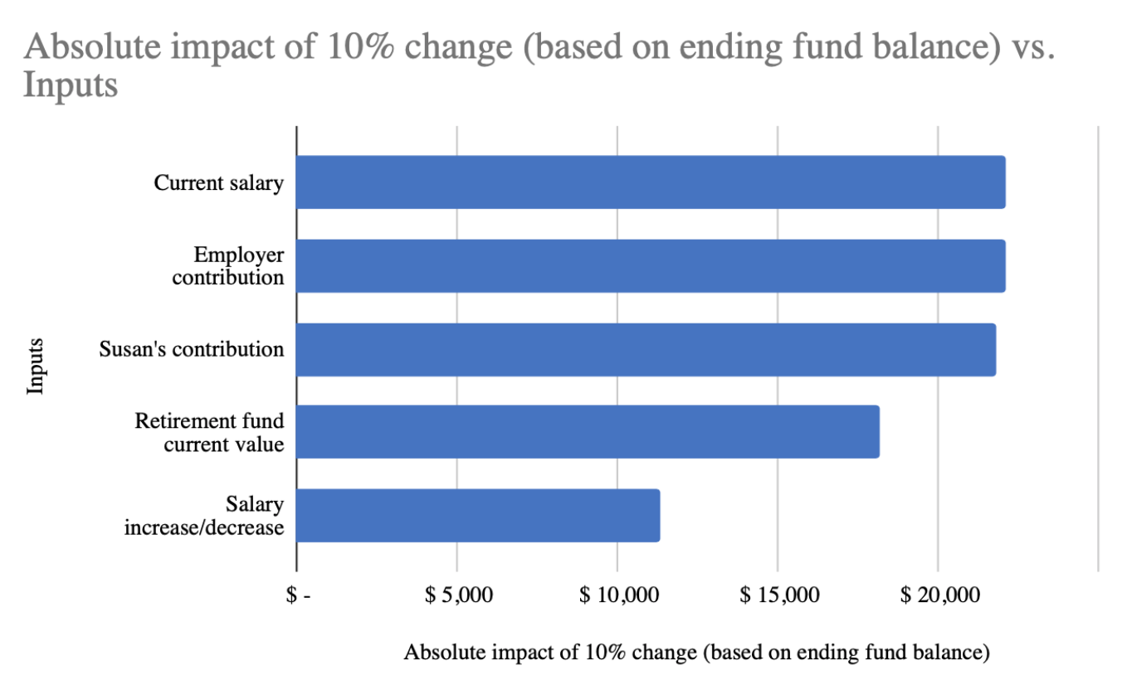
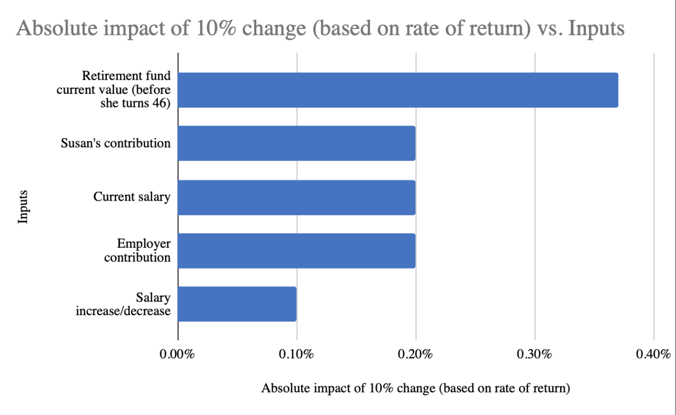
Generating Insights
Notes:
Jenny
Comparing the effects of all inputs

Slide 8
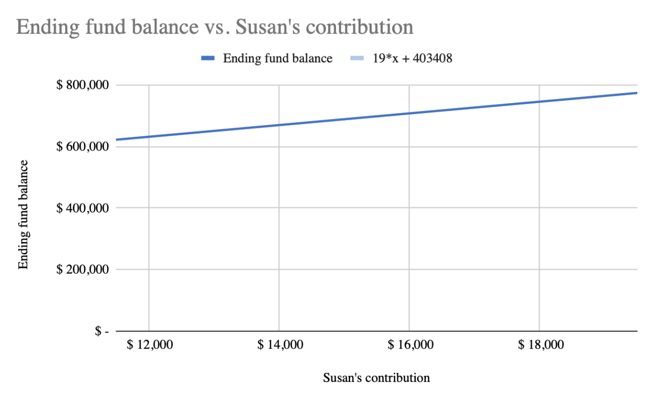
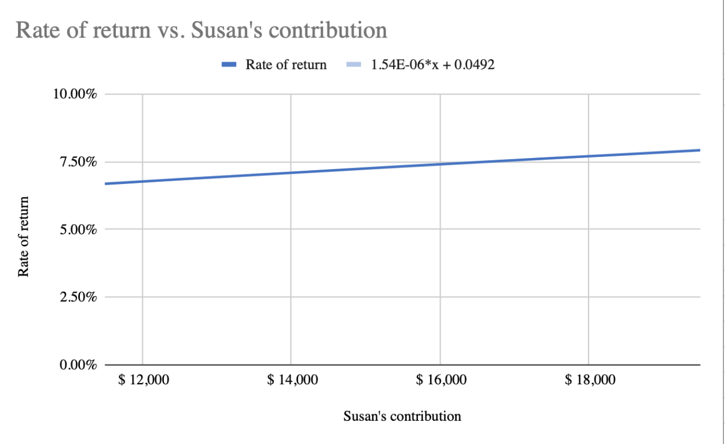
Generating Insights
Notes:
Jenny

Slide 9
Predictive analytics
Y = 19x + 403408 ( y is ending fund balance, x is Susan’s contribution)
X = 11,500 => y = $621,908
X = 30,000 => y = $973,408
Y = 1.54E-06x + 0.0492 (y is rate of return, x is Susan’s contribution)
X = 11,500 => y = 6.7%
X = 30,000 => y = 9.5%
Notes:
anna

Slide 10
Conclusion and Recommendations
Amount that Susan has when she retires is $621,098 with a rate of return of 6.68% (more than amount needed of $500,000)
If she continues at her current rate, Susan will have adequate savings by the time she retires
If Susan wants to retire with more money, I recommend that she increase her own contribution
Notes:
jenny

Slide 11
Thank you for listening!

